Slide 1
AI Foundry
For .NET Devs

Slide 2
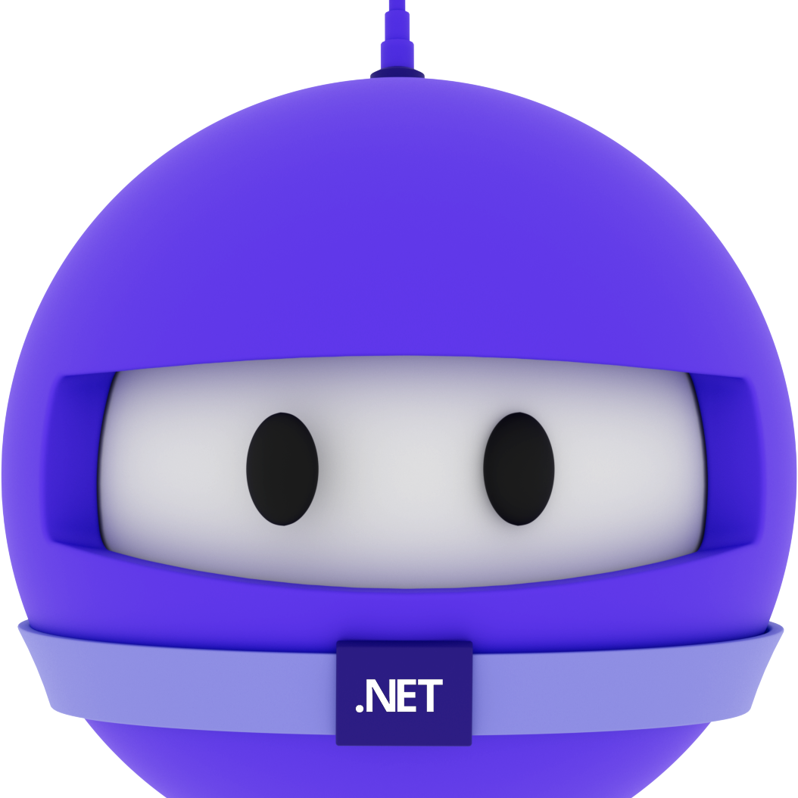
Bruno Capuano
Principal Cloud Advocate http://aka.ms/elbruno

Slide 3
With Azure AI Foundry now generally available, developers can access over 1,900 AI models with enterprise-grade multi-agent orchestration—bringing a new era of intelligent and autonomous computing.
Scott Guthrie
Executive Vice President, Cloud + AI

Slide 4










Azure AI Foundry
Copilot Studio
Foundry Models
Cloud
Visual Studio
Foundry Agents
Azure
Azure Arc
GitHub
Azure AI Search
Azure AI Services
Azure Machine Learning
Azure AI Content Safety
Foundry Local
Foundry SDK
Foundry Observability
Edge
Security • Identity • Management
Control
Azure Kubernetes Service
Azure App Service
Azure Container Apps
Azure Functions
Serverless

Slide 5

Azure AI Foundry
Let’s start!

Slide 6
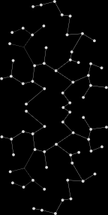
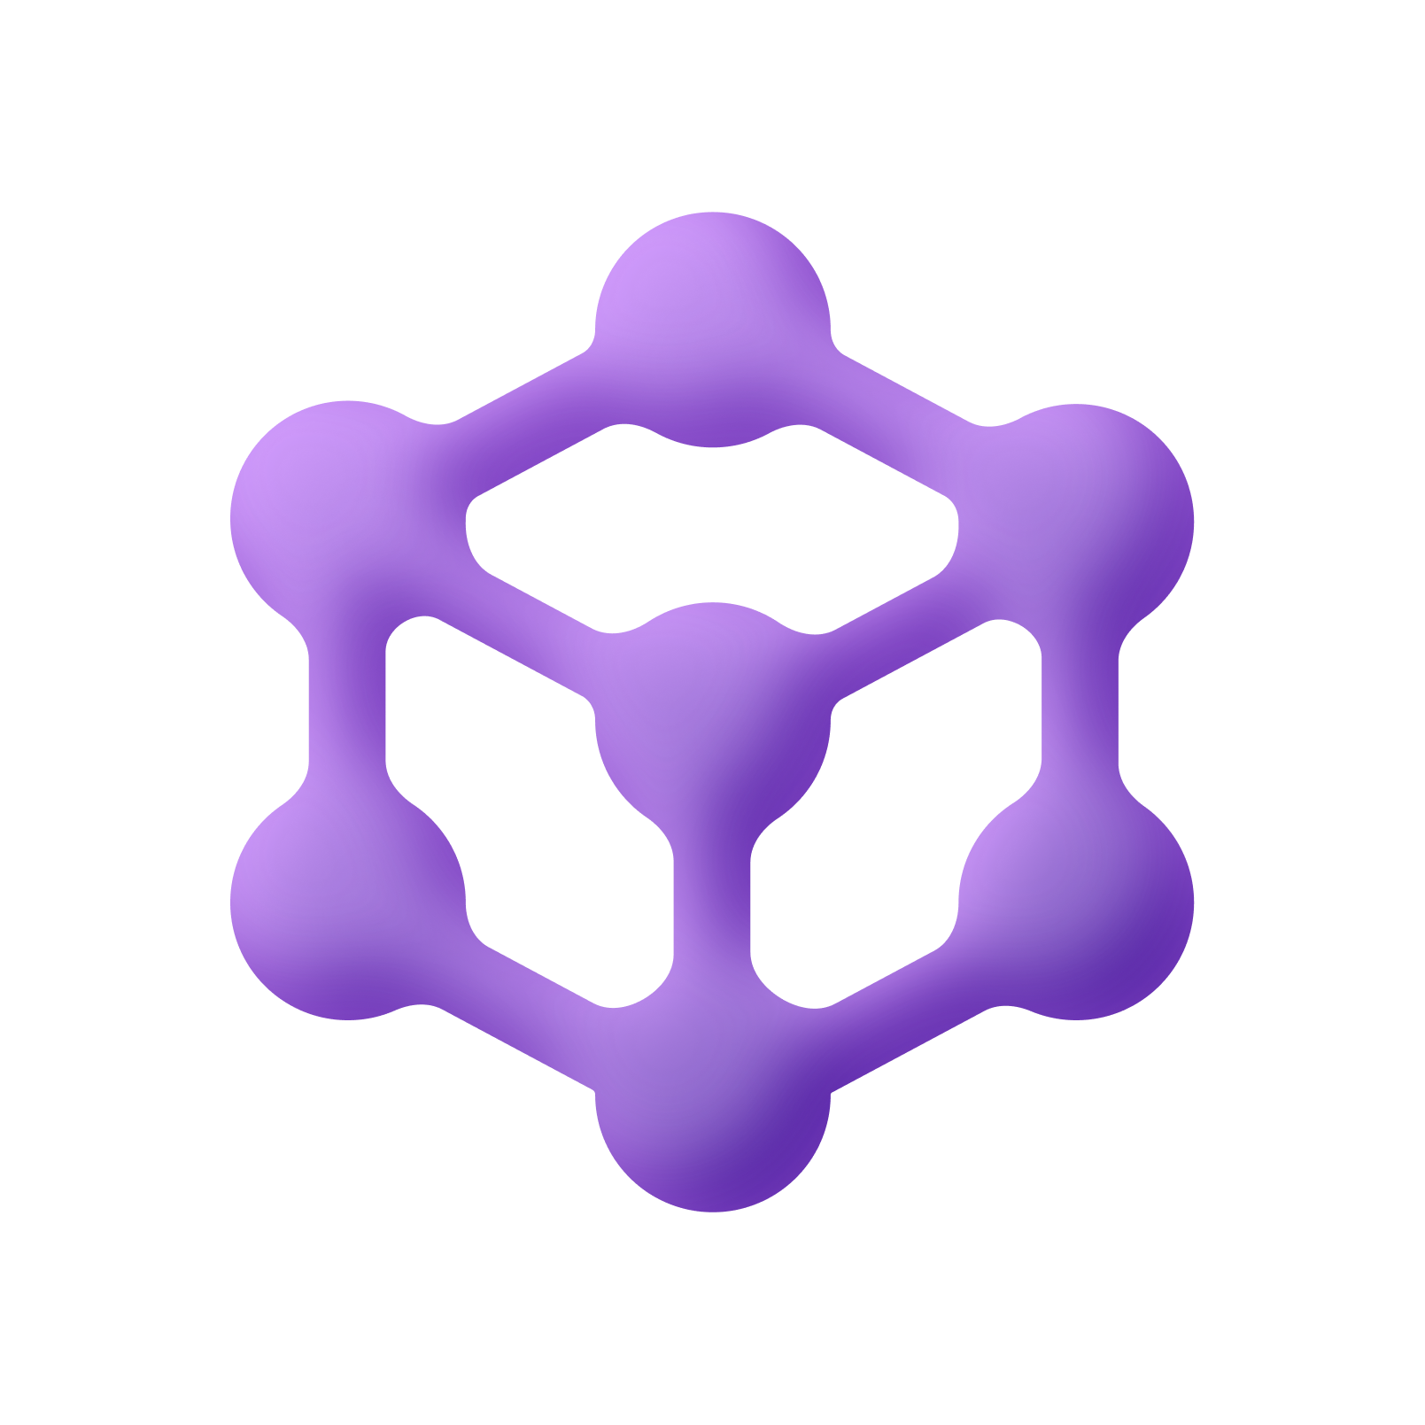
Microsoft Agent Framework
Public Preview
Open-source engine for building and orchestrating intelligent AI agents
Open Standards & Interoperability
Pipeline for Research
Community-Driven & Extensible by Design
Ready for
Production
aka.ms/AgentFramework

Slide 7


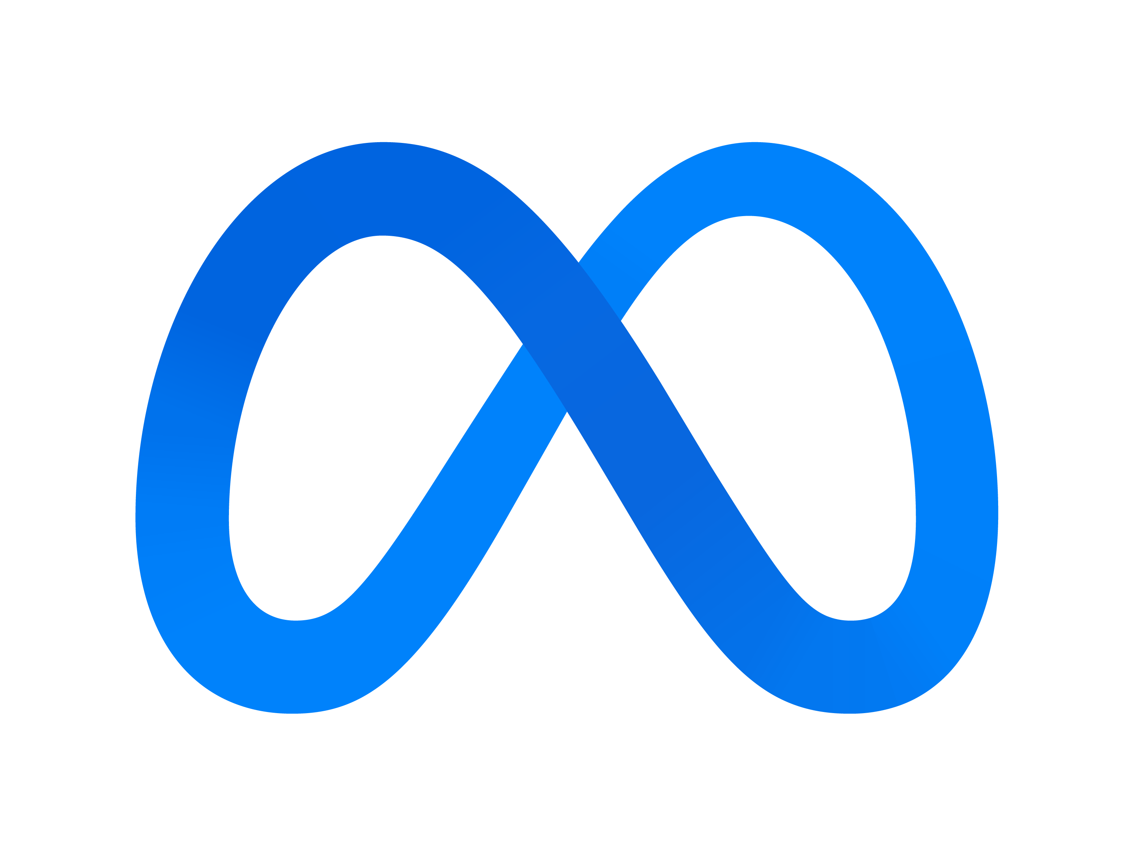

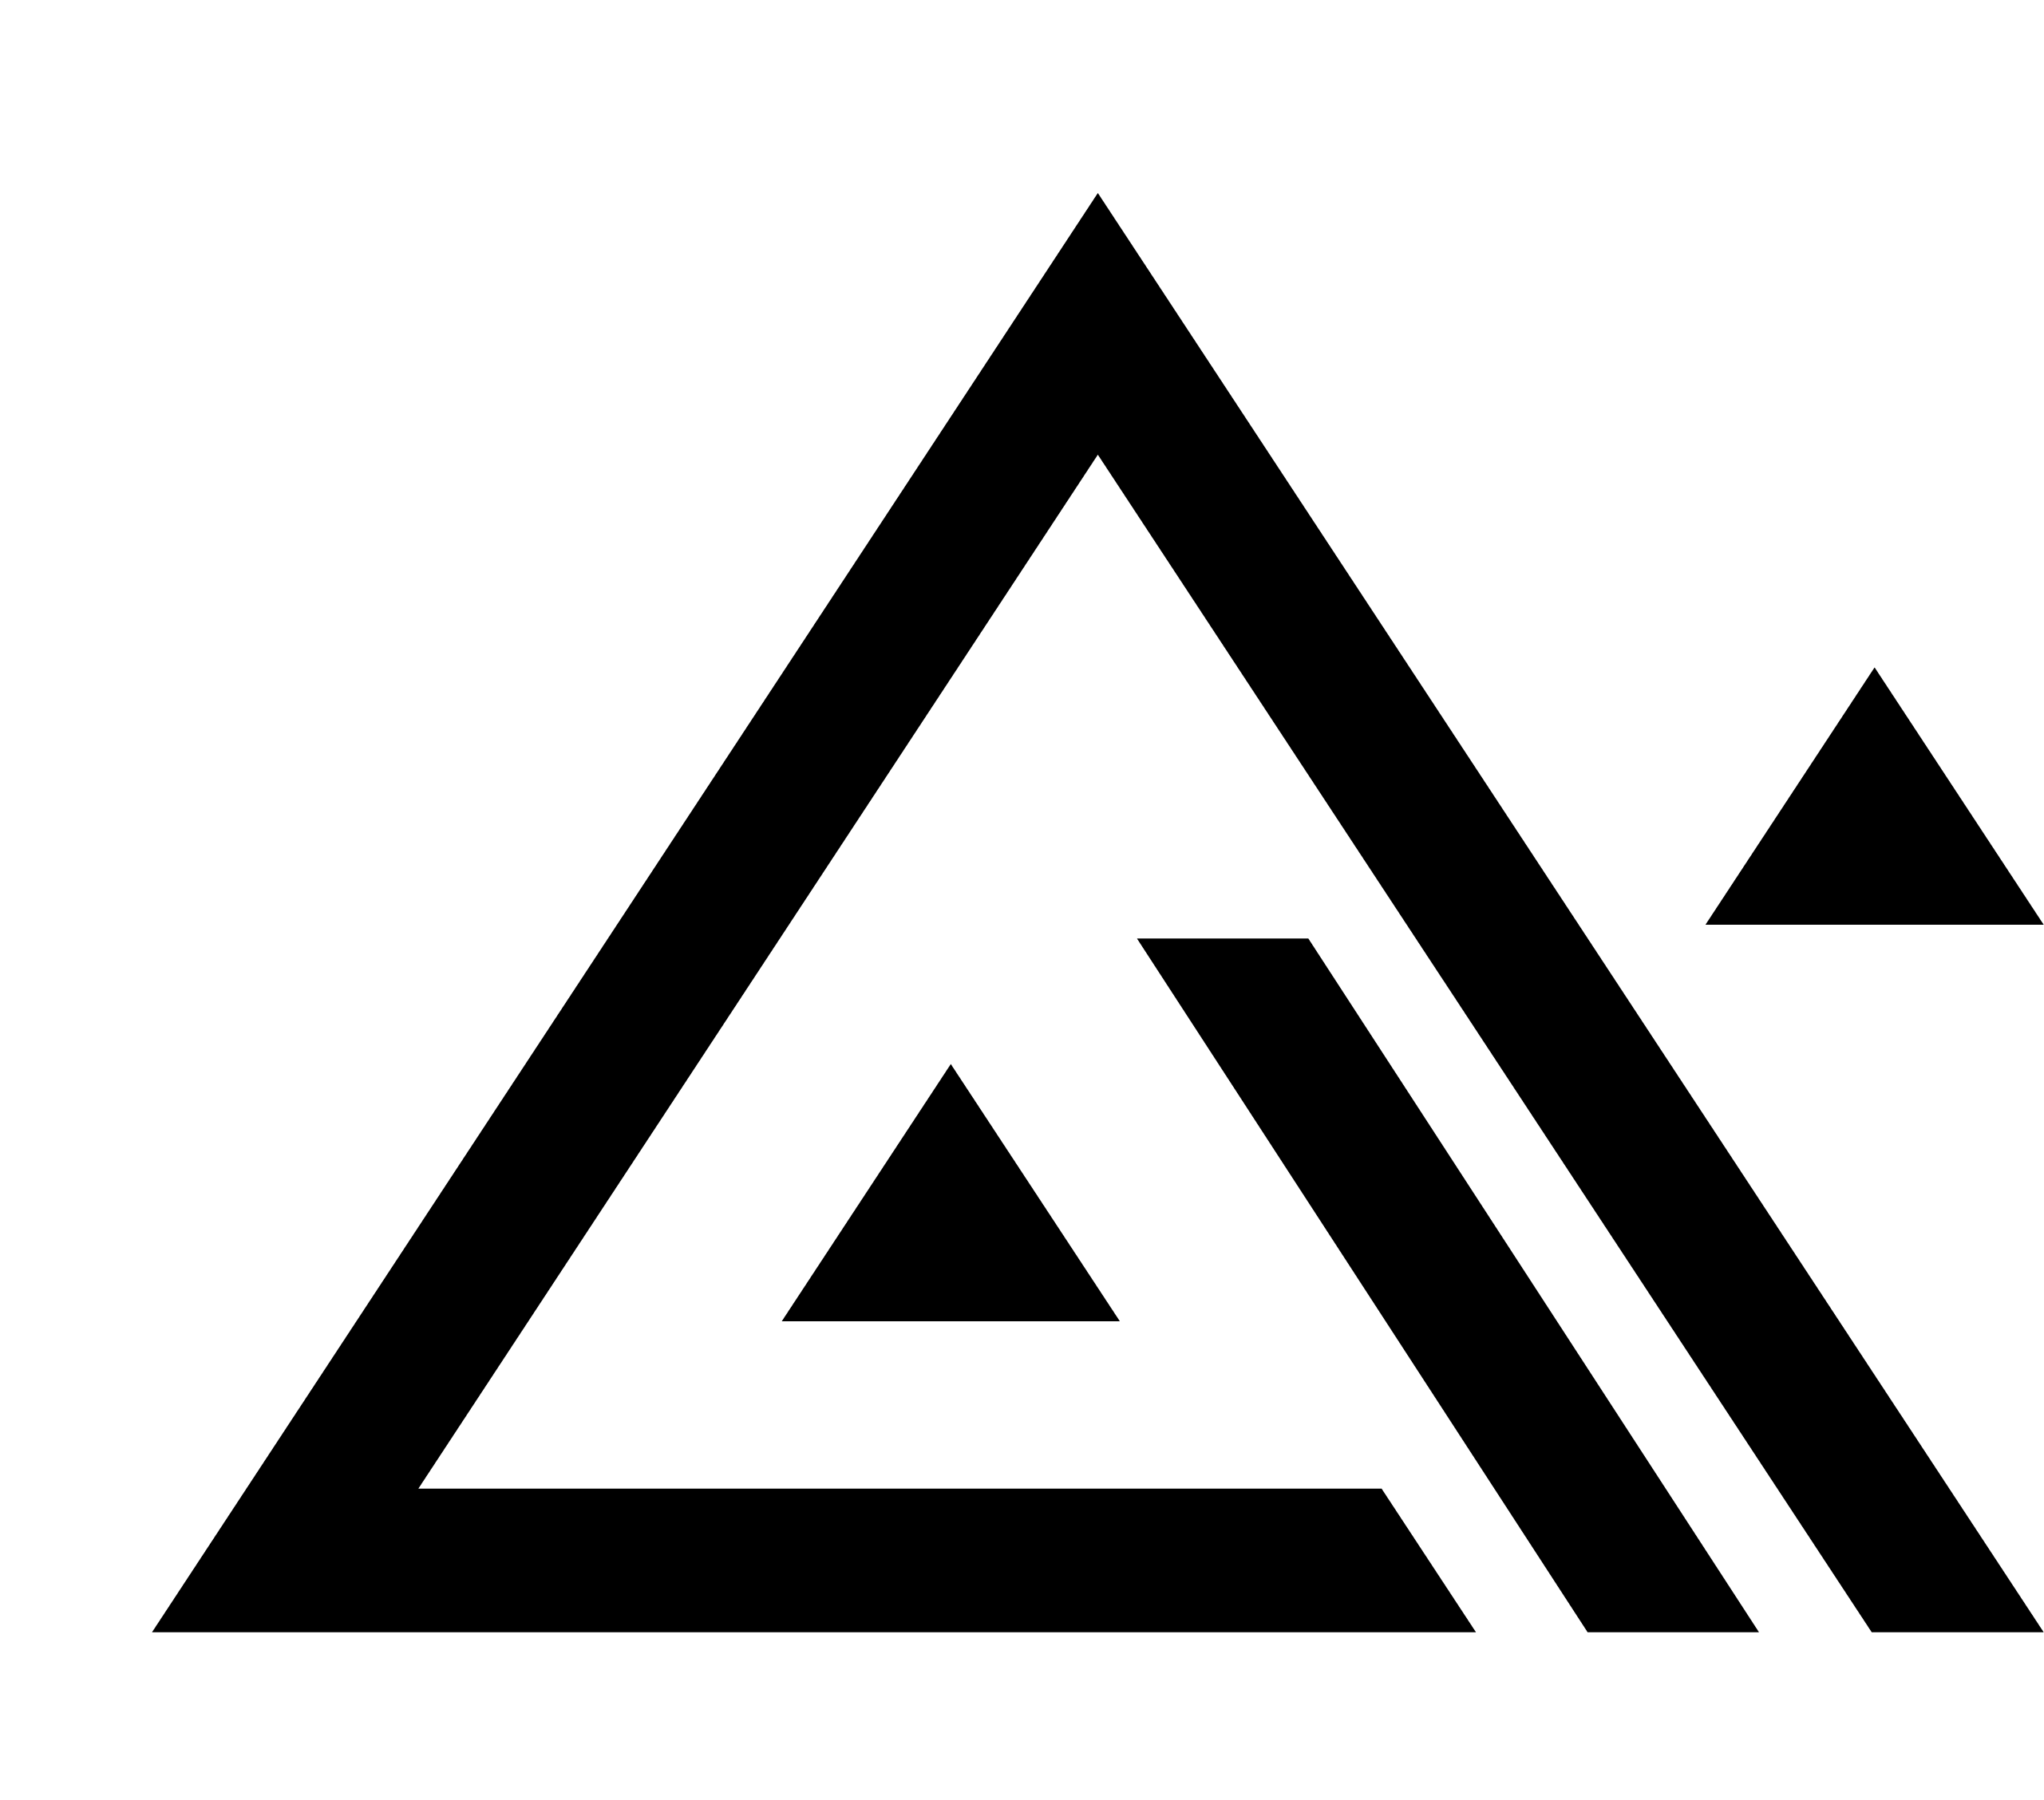





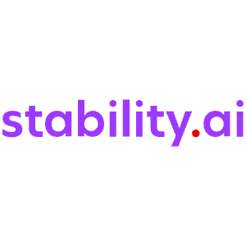
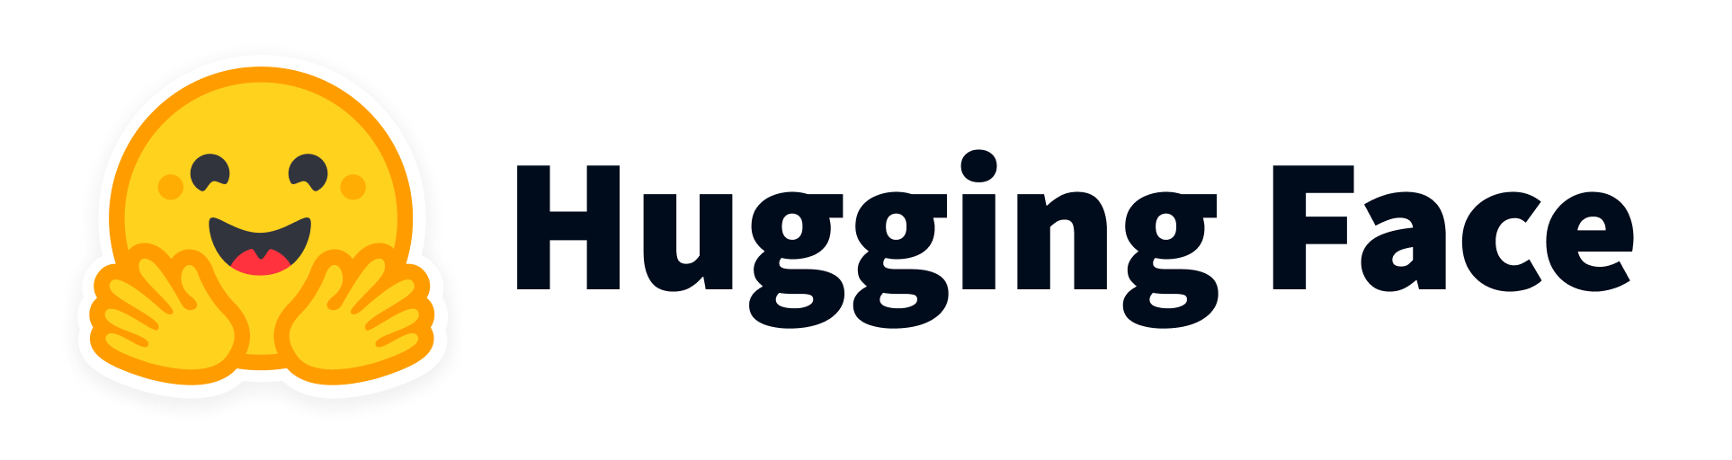











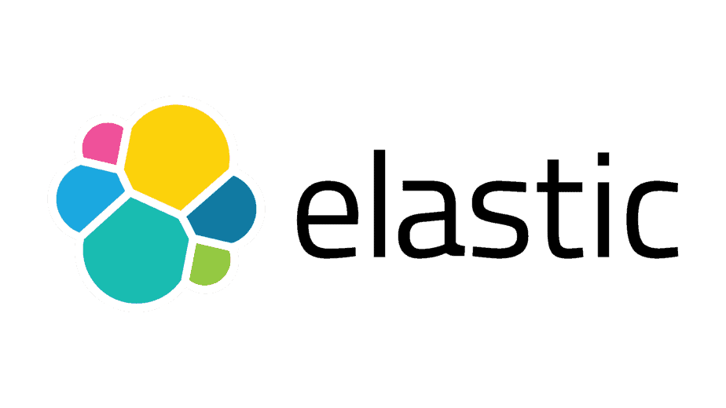



Authoring Tools
Foundry Models
Visual Studio
GitHub
Azure AI Foundry
AI Agent Ecosystem
OpenAI
Llama
Grok
Flux
Mistral
Knowledge
Agent catalog
Ready-made agents to kickstart your agent workforce
Phi
Cohere
Microsoft Fabric
Stability
Industry Models
Azure Cosmos DB
SharePoint
Foundry Labs
Microsoft Agent Framework
Client SDKs for enterprise and production agentic systems
Microsoft Graph
Muse
Magentic-One
Azure AI Search
Aurora
OmniParser
Agent tools
Orchestration
Channels
Microsoft Bing
Open Ecosystem
Enterprise Trust
Foundry Agent Service
Deploy and manage agents with fully-managed runtime
Protocols
A2A
MCP
OpenAPI
VNet deployments
Connectors
OBO Auth
Multi-agent workflows
Built-in threads
Long-term memory
Google VertexAI
Amazon Bedrock
CrewAI
LangChain
BYO-resources
ElasticSearh
Pinecone
Evaluation
Tracing & Monitoring
Governance + Safety
Managed Identities
Logic Apps
Azure Functions

Slide 8
Azure AI Foundry
AI Foundry Agents

Slide 9
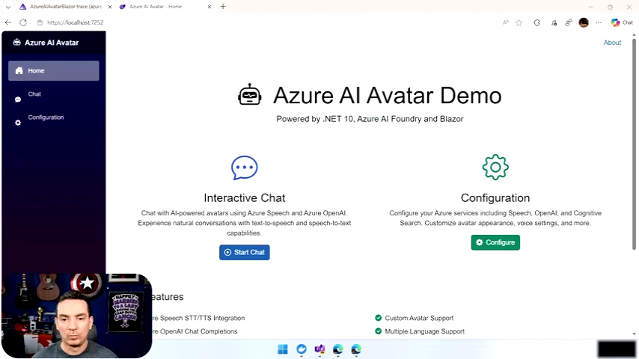

Slide 10
Thank you

